Slide 1
Audit Log Analysis

Slide 2
Table of contents
01
02
03
05
04
Introduction
Data source
Data Transformation
Visualization

Slide 3
01
Introduction
This dashboard provides information on the number of tickets raised, their current states, the duration for completing each ticket, year-wise ticket distribution, and details about the individuals who resolved the tickets.

Slide 4
02
Data Source
We collected the dataset from the Kaggle platform.
https://www.kaggle.com/datasets/vipulshinde/incident-response-log?select=incident_event_log.csv

Slide 5
03
Data Transformation
After collecting the dataset from the Kaggle website, we utilized MSSQL to store it in a database. Subsequently, in MSSQL, we performed transformations such as changing columns with "?" to "N/A" and calculated the duration using the "opened at" and "closed at" date columns. Finally, employing the Import mode method from Power BI to SQL Server, we executed additional transformations on the data.
Post-transformation, DAX (Data Analysis Expressions) was employed to create new columns and measures for the purpose of conducting a comprehensive analytical analysis.

Slide 6
04
Visualization

Slide 7
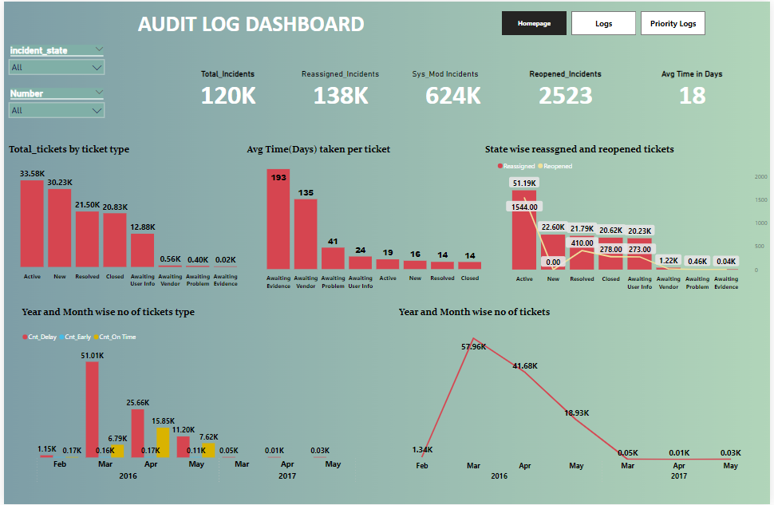
Audit log Dashboard

Slide 8
Total number of tickets was 120K
Reassigned tickets totaled 138K
sys_mod_tickets amounted to 624K
2523 reopened incidents
18 days Average time taken

Slide 9
Using a Column chart, we illustrated the ticket counts based on their respective ticket types. The chart reveals that the "Active" state had 33.58K tickets, "New" tickets totaled 30.32K, "Resolved" tickets stood at 21.50K, "Closed" tickets amounted to 20.83K, while "Awaiting User Info" accounted for 12.88K, "Awaiting Vendor" tickets were 0.56K, "Awaiting Problem" tickets were 0.40K, and "Awaiting Evidence" tickets were 0.02K.
The average time for completing a ticket was 18 days, and I created a column to represent the average time taken for each ticket state. Specifically, tickets in the "Awaiting Evidence" state took an average of 193 days, "Awaiting Vendor" tickets took 135 days, "Awaiting Problem" tickets took 41 days, "Active" tickets took 19 days, "New" tickets took 16 days, and "Resolved" and "Closed" tickets took an average of 14 days.
Line chart to illustrate the number of tickets year and month-wise. It was evident that March of the year 2016 had the highest count, totaling 57.96K tickets, while May of the year 2017 marked the lowest count with 0.03K tickets.

Slide 10
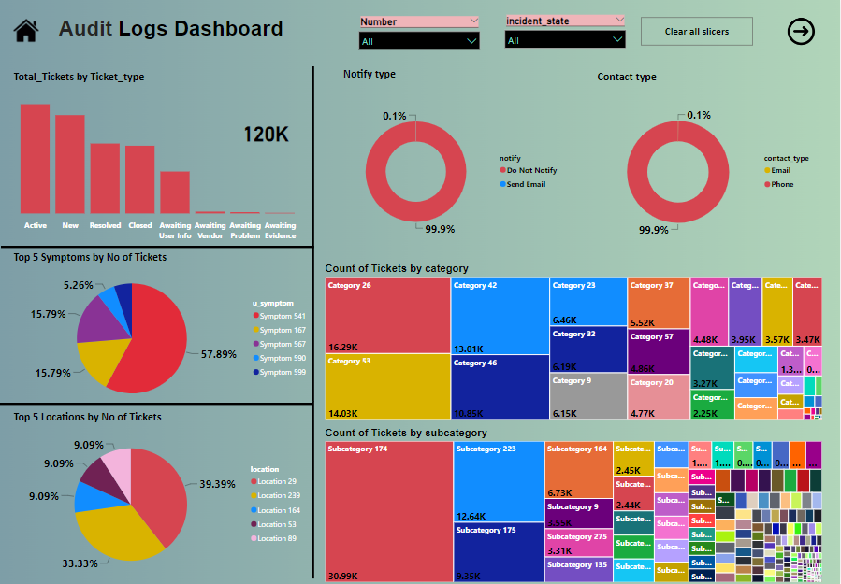
Audit log Dashboard

Slide 11
Donut chart illustrate how tickets were reported. Phone type reports dominated, occupying 99.9%, while email type reports constituted a minor percentage at 0.1%.
Bar Chart illustrate the distribution of the top symptoms among the total number of tickets. The representation is as follows:
Symptom 541, occupying 57.89%.
Symptom 161, accounting for 15.78%.
Symptom 567, constituting 15.79%.
Symptom 590, making up 5.26%.
Symptom 599, representing 4.89%.
used bar chart to depict the distribution of the top countries within the overall ticket count. The representation is as follows:
• Country 29, occupying 39.39%.
• Country 239, accounting for 33.33%.
• Countries 164, 53, and 89, constituting 9.09%.

Slide 12
Bar chart to depict the distribution of the top countries within the overall ticket count. The representation is as follows:
• Country 29, occupying 39.39%.
• Country 239, accounting for 33.33%.
• Countries 164, 53, and 89, constituting 9.09%.
A tree map was generated to illustrate the count of tickets based on both country and subcategory. In this visual representation, each category is represented by a colored rectangle, and the size of each rectangle corresponds to a specific quantitative value. Notably, category 28 exhibited the highest count with 16.29K records, making it the highest in the categorical hierarchy. Similarly, subcategory 174 stood out with the highest count of 30.99K records within the sub categorical hierarchy.

Slide 13
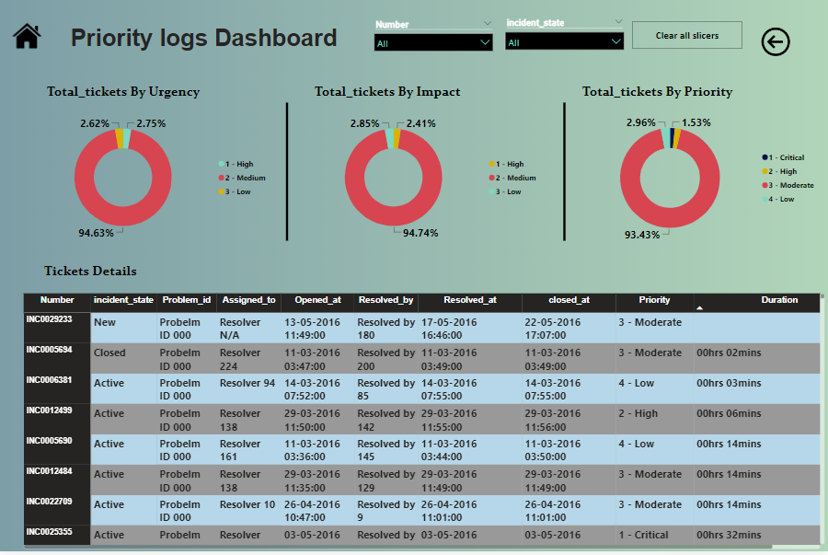
Priority log Dashboard

Slide 14
Three donut charts illustrate on the total number of tickets, each representing different categories: urgency, impact, and priority.
Urgency Category:
Medium urgency tickets occupy the majority at 94.63%. Low urgency tickets account for 2.62%. High urgency tickets represent 2.75%. Impact Category:
Medium impact tickets dominate with 94.74%. Low impact tickets constitute 2.85%. High impact tickets make up 2.41%. Priority Category:
Medium priority tickets cover the highest proportion at 93.34%. Low priority tickets comprise 2.96%. High priority tickets represent 2.33%. Critical priority tickets make up 1.53%.

Slide 15
Generated a comprehensive table providing detailed information about each ticket. The table includes the following fields:
Ticket Number: A unique identifier for each ticket.
Ticket Type: The category or type of the ticket.
Assignment To: The individual or department responsible for handling the ticket.
Opened At: The date and time when the ticket was initially reported or opened.
Resolved By: The entity or individual responsible for resolving the ticket.
Resolved At: The date and time when the ticket was successfully resolved.
Priority: The level of urgency or importance assigned to the ticket.
Closed At: The date and time when the ticket was officially closed.
Duration Per Closed Ticket: The time taken to resolve and close each ticket.

Slide 16
Thank you

